Slide 1
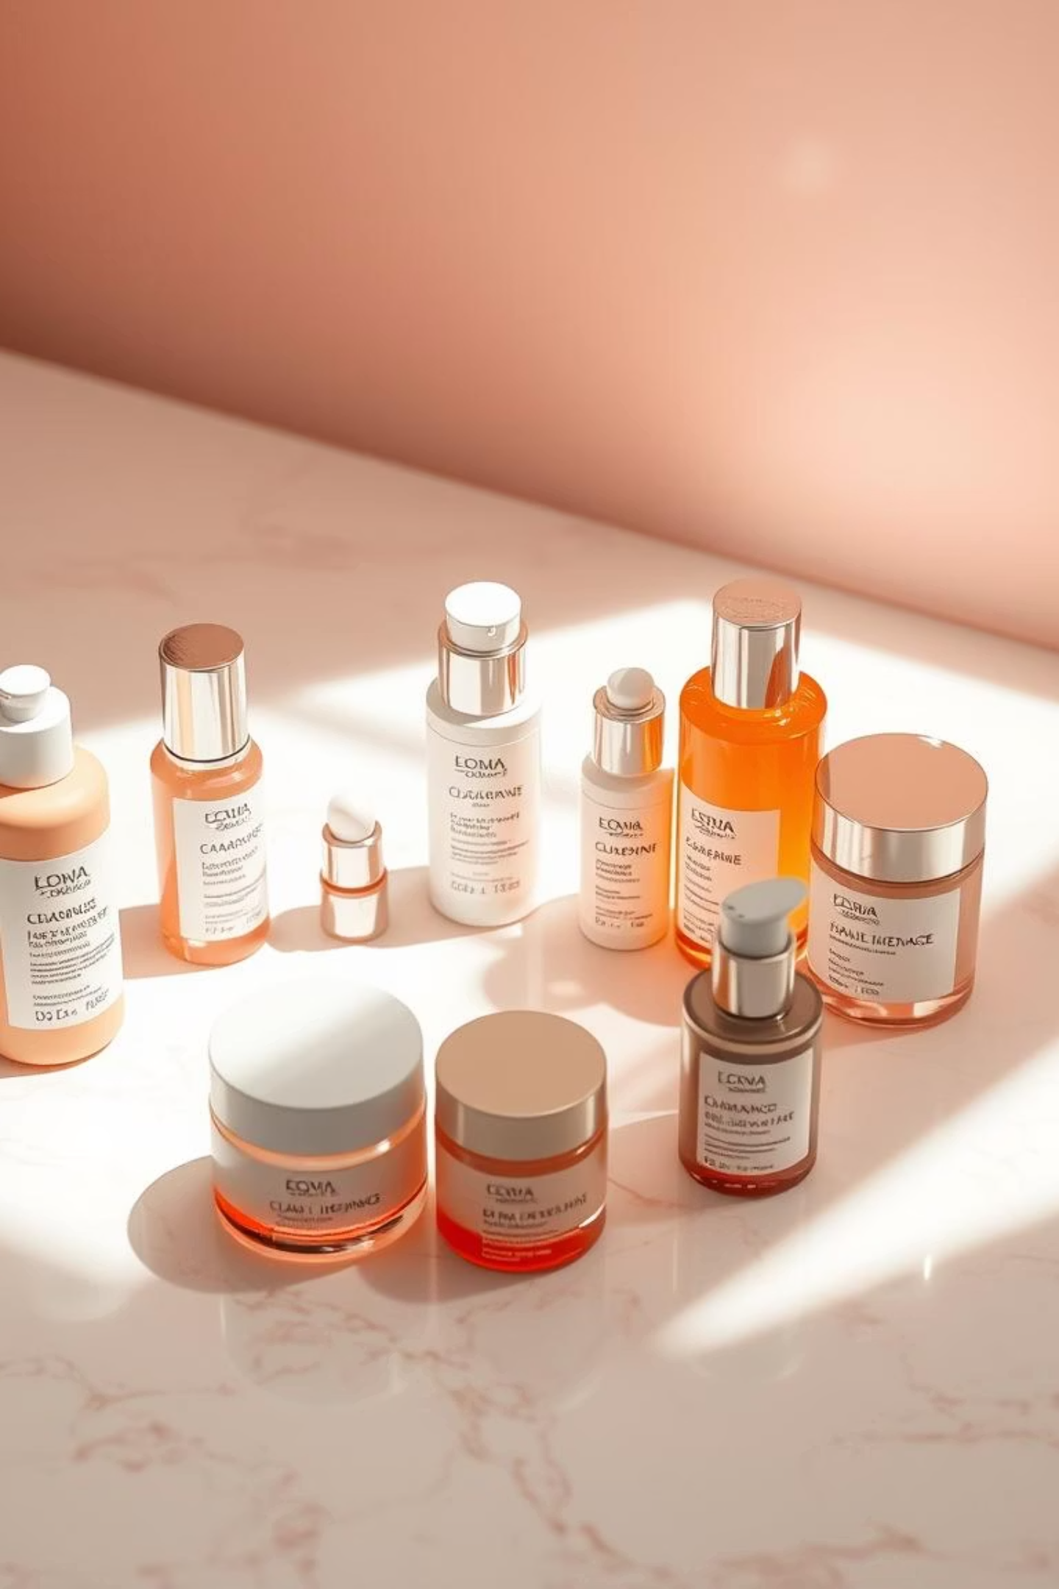
Nimilicious Stash: Leading the Korean Skincare Revolution
Key Points
Nimilicious Stash blends traditional herbal wisdom with advanced biotechnology to deliver transformative, holistic skincare. Experience the difference of radiant, youthful-looking skin.

Slide 2

Unveiling the Essence of Nimilicious Stash
Discover Nimilicious Stash
Blended Tradition & Innovation
Radiant, Healthy Skin
K-Beauty Excellence
Our core mission is to deliver genuinely radiant and healthy skin through the power of natural, meticulously sourced ingredients.
Embracing K-beauty's hallmarks: gentle yet effective, and thoroughly science-backed formulations that truly transform your complexion.
A rising Korean skincare brand that seamlessly blends time-honored Korean beauty traditions with cutting-edge scientific innovation.

Slide 3

Organic Ingredients
Cruelty-Free
Radiant Healthy Skin
Innovative Formulas

Slide 4

The Korean Skincare Revolution
Korea continues to lead global beauty innovation, often cited as being 12+ years ahead in advanced skincare science. This rapid pace of development ensures that consumers receive the most effective and forward-thinking products.
Brands like Nimilicious Stash harness this advantage, combining cutting-edge research with the power of natural botanicals. Our formulations are designed to provide visible results while maintaining skin health.
Korean skincare routines emphasize layering, deep hydration, and robust skin barrier health. This holistic approach ensures long-term skin vitality, moving beyond temporary fixes to cultivate lasting radiance.

Slide 5

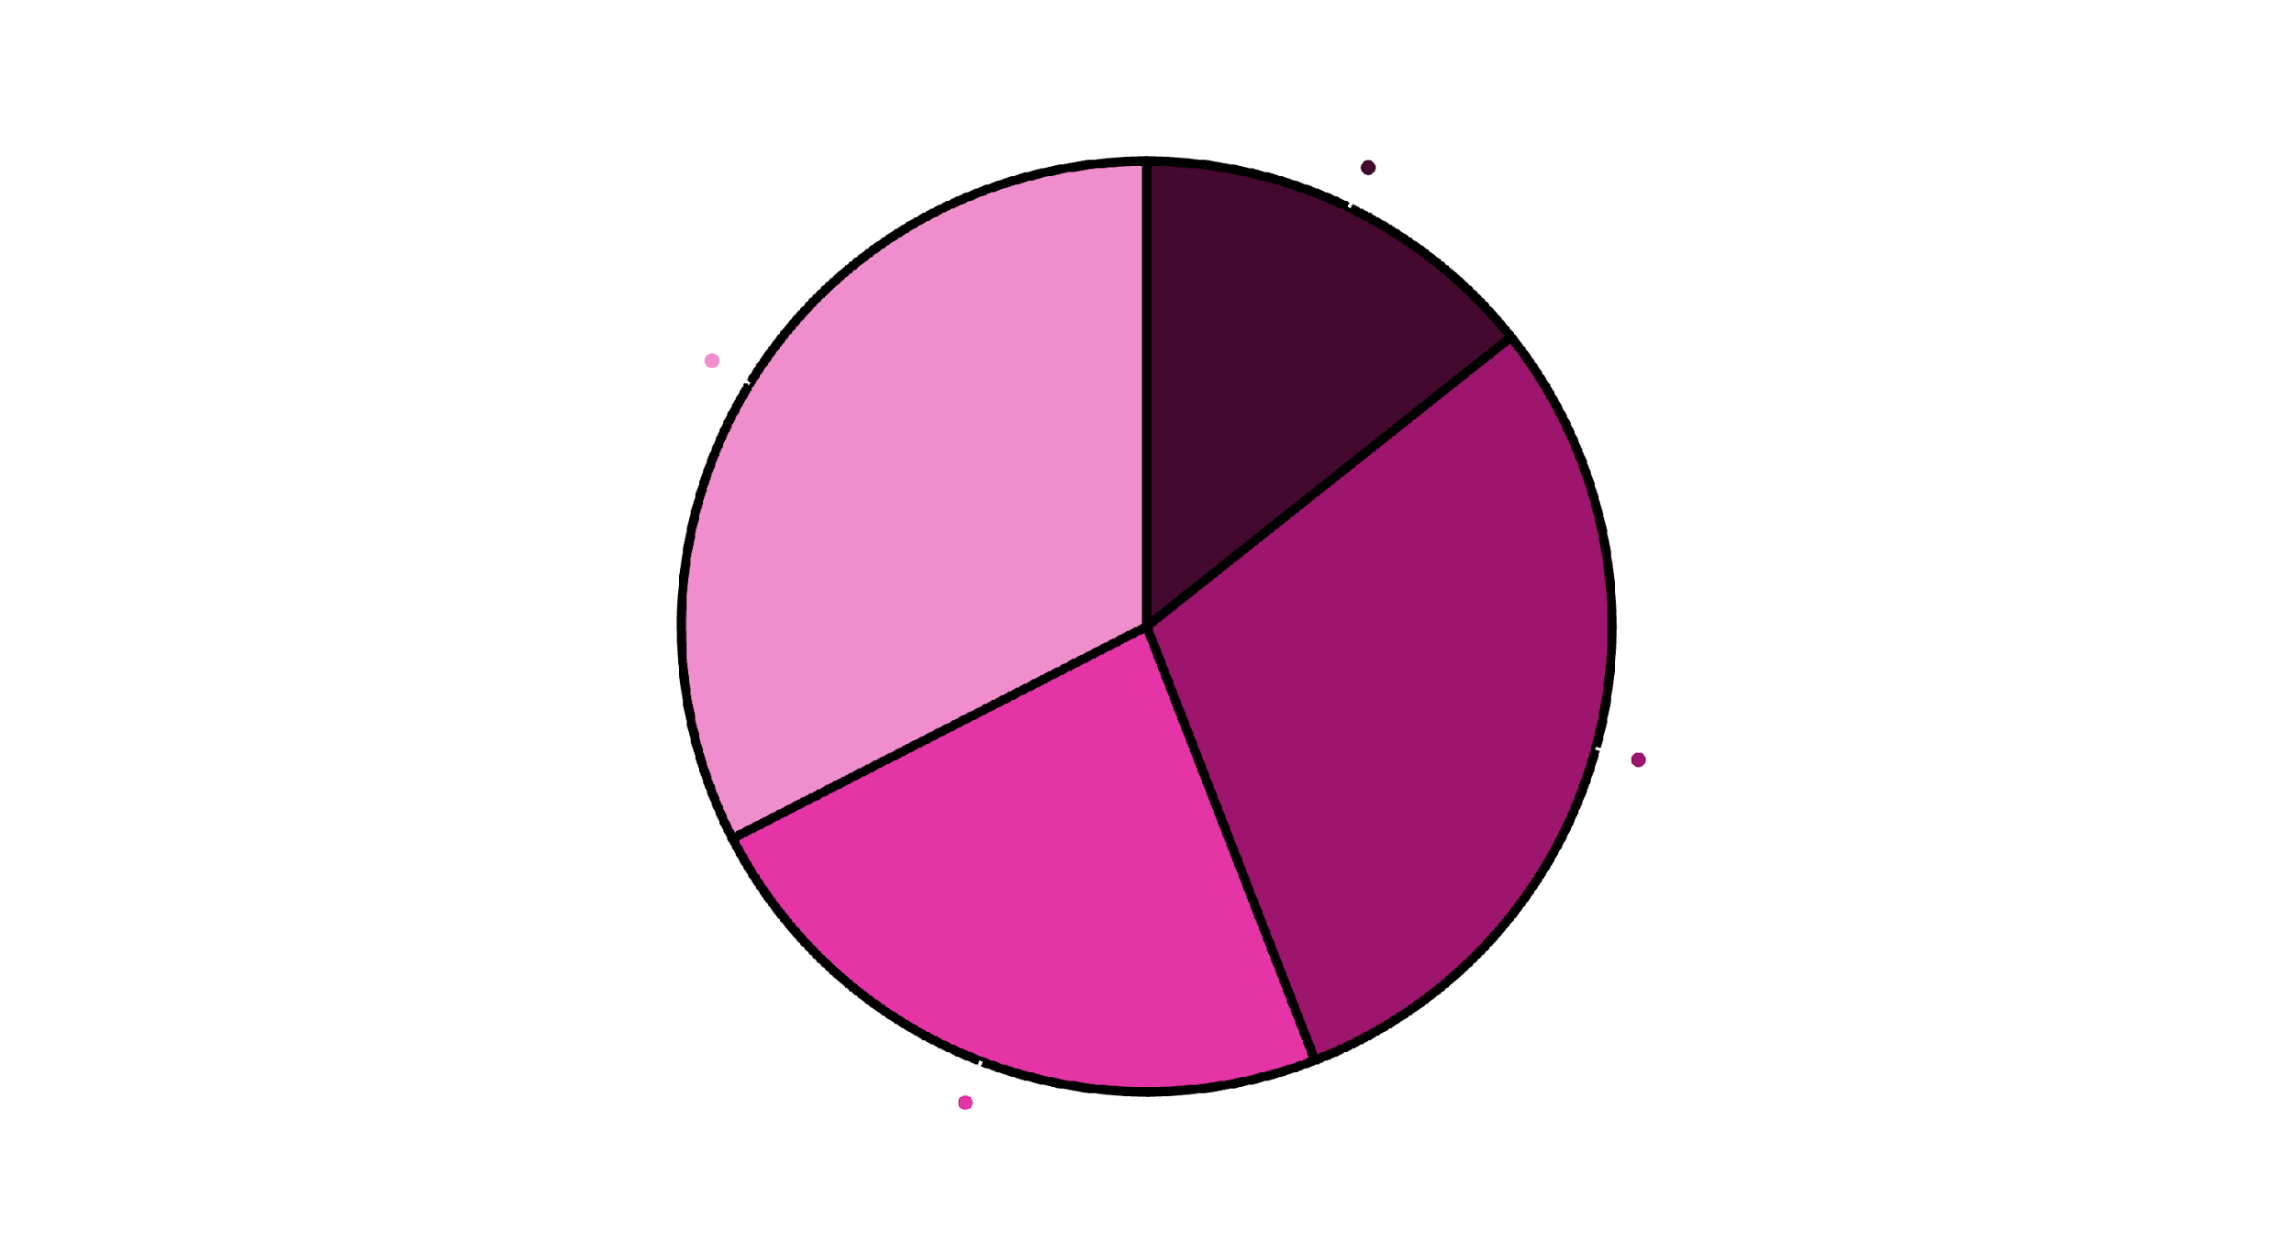
Quarterly Sales Performance
This pie chart illustrates the distribution of sales across the four quarters, providing a clear visual representation of each quarter's contribution to the total annual sales.
Q1
Q2
Q3
Q4

Slide 6
Unlock Your Skin’s Potential
Signature Products of Nimilicious Stash
1
Hydrating Hyaluronic Toner
2
Ampoule Concentrate
A deeply penetrating toner that boosts moisture levels, preparing your skin for optimal absorption of subsequent products.
A potent, concentrated blend of active ingredients designed for intensive skin repair and to enhance a radiant, healthy glow.
3
Bean Cream
4
Fig Face Mask
A nourishing yet lightweight moisturizer, perfect for all skin types, providing balanced hydration without heaviness.
Infused with natural antioxidants from figs, this mask revitalizes and rejuvenates the skin, leaving it soft and supple.

Slide 7

Awareness
Discover signature products
Consideration
Trial
Learn product benefits
Try Hydrating Toner & Ampoule
Purchase
Buy Bean Cream or Mask
Loyalty
Repeat customers & referrals

Slide 8




The Science Behind the Radiance
Power Ingredients That Set Nimilicious Apart
Hyaluronic Acid
Fermented Botanicals
A hydration powerhouse, retaining immense moisture to instantly plump and smooth the skin, reducing the appearance of fine lines.
Enhanced nutrient absorption and skin vitality through unique fermentation processes that break down ingredients for deeper efficacy.
Antioxidant-Rich Extracts
Gentle Formulations
Featuring fig and ginseng berry, these extracts provide potent anti-aging benefits, protecting skin from environmental damage.
Crafted with utmost care, our non-irritating formulations are perfectly suitable for even the most sensitive skin types.

Slide 9

Antioxidant Extracts
Bean Cream
Hyaluronic Acid
Fermented Botanicals
Gentle Formulations
Fig Face Mask

Slide 10

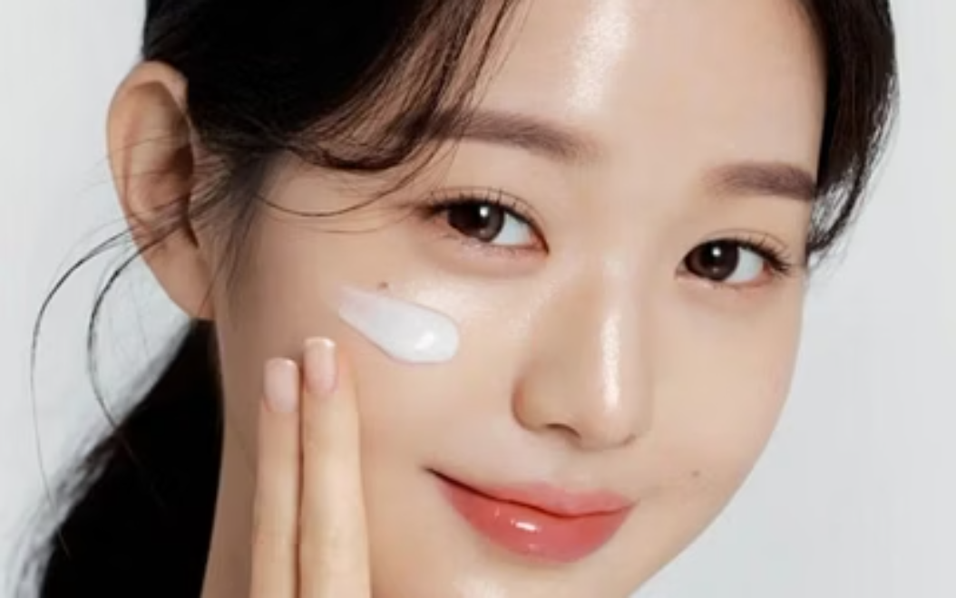
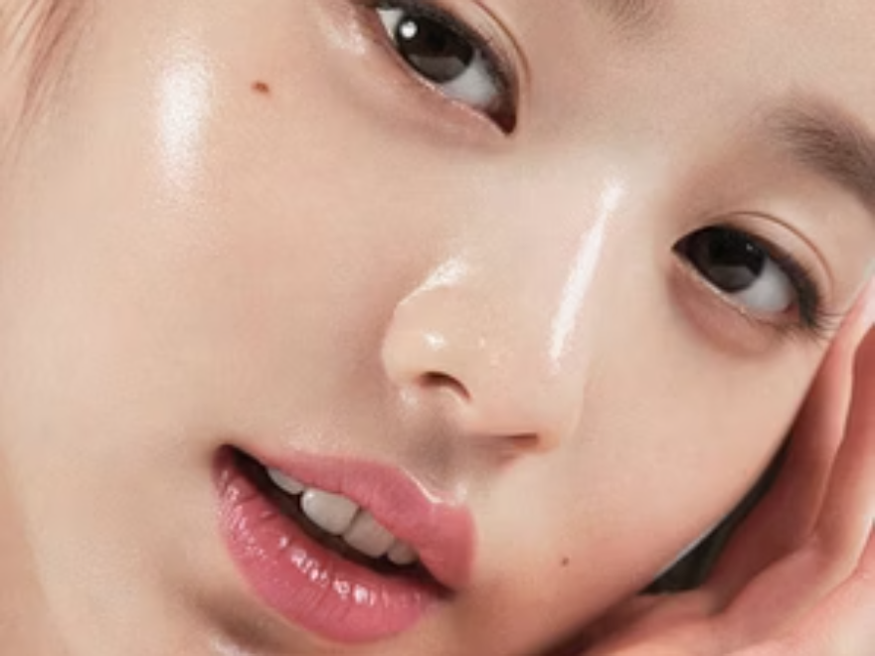
Real Results: Customer Transformations
Our customers consistently report remarkable improvements. Users have seen clearer, more glowy skin within weeks of consistent use, a testament to our products' efficacy. Testimonials frequently highlight significantly improved hydration, a noticeable reduction in redness, and a much smoother skin texture. Nimilicious Stash’s products are designed to integrate seamlessly into daily routines, making the path to healthier skin effortless and enjoyable.

Slide 11







Key Considerations: A Comparative Analysis
This section outlines the essential elements and contrasting viewpoints to facilitate a comprehensive understanding of the topic at hand. We will examine opposing perspectives to highlight critical distinctions and inform our strategic direction.
Preventive, hydration-focused, long-term results.
Quick fixes, targets visible concerns.
Ordinary Skincare
Korean Skincare
Minimal (2–4 steps).
Multi-step layering (5–10 steps).
Faster results, risk of irritation.
Gradual glow, barrier strengthening.

Slide 12
Our Promise to the Planet
Nimilicious Stash’s Commitment to Sustainability
Eco-Friendly Packaging
Cruelty-Free Testing
We prioritize the planet with recyclable and sustainable packaging, minimizing environmental impact.
Our dedication to ethical beauty means all products are rigorously tested without any animal involvement.
Responsibly Sourced Ingredients
Ethical Beauty Alignment
Ingredients are carefully sourced from trusted Korean farms, ensuring purity and supporting local communities.
We align with global trends towards ethical consumption, offering beauty that you can feel good about, inside and out.

Slide 13
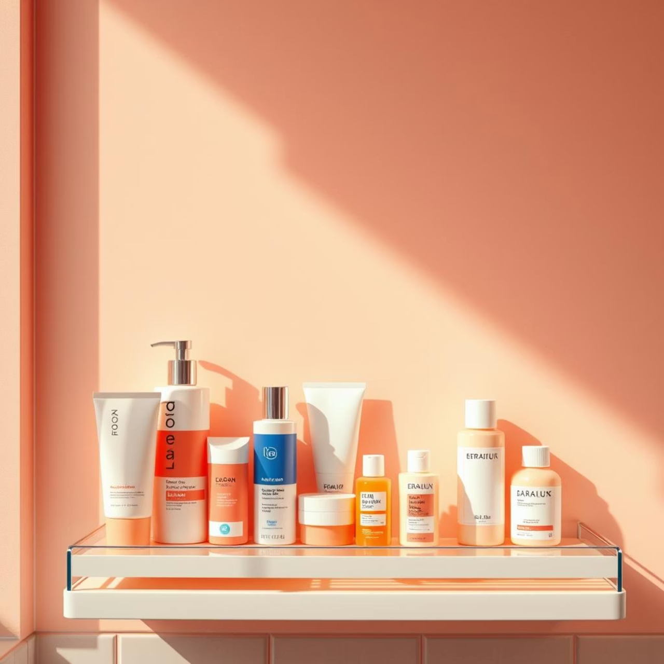
How Nimilicious Stash Fits Your Routine
Nimilicious Stash products are ideal for those with combination and sensitive skin types who are seeking balance, deep hydration, and a natural glow. Our formulations work harmoniously with your skin, helping to regulate oil production in combination areas while providing soothing care for sensitivity.
Whether you prefer a comprehensive multi-step Korean skincare ritual or a more minimalist regimen, our products seamlessly integrate into any routine. Each item is designed to complement others, building layers of benefits without feeling heavy or overwhelming.
Our philosophy encourages a focus on long-term skin health over quick fixes. By nourishing and supporting your skin's natural functions, Nimilicious Stash promotes lasting radiance and resilience, helping you achieve healthy, beautiful skin every day.

Slide 14





Leading the Next Chapter in K-Beauty
Market Position & Growth Potential
Core Brand
Nimilicious Stash unique K-beauty identity.
Primary Market
Dedicated K-beauty consumers and fans.
Growth Opportunities
Regional expansion and product lines.
External Influences
Trends, retail partners, and regulations.
Nimilicious Stash is strategically positioned as an emerging brand within the burgeoning global K-beauty market, projected to exceed $20 billion by 2025. Our unique blend of tradition and innovation appeals directly to both millennials and Gen Z, who actively seek authentic, effective, and ethically produced skincare solutions. We are poised for significant international expansion, leveraging a robust digital-first marketing strategy and strategic influencer partnerships to reach new audiences worldwide.

Slide 15



Join the Nimilicious Stash Journey
Experience Korean skincare innovation rooted in nature and science, and unlock your skin’s natural glow with Nimilicious Stash today.

